Slide 1


SUBJECT- Final Year Project
Department:- Computer Engineering
A
Final Year Project presentation
on
“Drug Typing using Patient Data”
Prepared By
Mr. Aditya Vitthal Papal Exam Seat No./ PRN:- 72203097F
Ms. Shravani Jayendra Rane Exam Seat No./ PRN:- 72203129H
Ms. Diya Dinkar Satpute Exam Seat No./ PRN:- 72203150F
Guided by
Prof. Prachi Waghmare
PCET’S & NMVPM’S
NUTAN MAHARASHTRA INSTT. OF ENGG. & TECH. Pune
Academic Year 2024-25

Slide 2
SUBJECT- Final Year Project
Department:- Computer Engineering
Contents
Title
Introduction
Problem statement
Abstract
Objective
Approach
Methodology
Proposed system
Architecture
Future scope
Results
Conclusion
Academic Year 2024-25

Slide 3

SUBJECT- Final Year Project
Department:- Computer Engineering
Drug Typing Using Patient Data
Technology - Machine Learning
Domain – Healthcare
Academic Year 2024-25

Slide 4
SUBJECT- Final Year Project
Department:- Computer Engineering
Introduction
In the healthcare sector, prescribing the right medication is crucial for effective treatment and patient safety. However, selecting the most appropriate drug for a patient can be challenging due to the wide range of available drugs and the varying health profiles of patients. Factors such as age, gender, blood pressure, and cholesterol levels play a significant role in determining how a patient responds to a particular drug. Misjudgment in prescribing can lead to ineffective treatment or severe side effects.
In this project, we propose using machine learning to streamline the drug prescription process by developing a predictive model that analyzes patient data and suggests the most suitable drug. By leveraging patient health metrics, the system will classify patients into predefined drug categories, reducing the risk of human error and enhancing the overall quality of care. This project combines the fields of healthcare and machine learning, aiming to improve prescription accuracy and treatment outcomes.
Academic Year 2024-25

Slide 5
SUBJECT- Final Year Project
Department:- Computer Engineering
Problem Statement
Incorrect drug prescriptions can lead to ineffective treatments, increased health risks, and adverse drug reactions. With the growing complexity of medical data and patient variability, accurately determining the most suitable medication for each patient remains a challenge. This project aims to address this issue by developing a machine learning model that predicts the best drug type for a patient based on health metrics such as age, sex, blood pressure, and cholesterol levels. The goal is to improve prescription accuracy, reduce negative side effects, and enhance patient outcomes.
Academic Year 2024-25

Slide 6
SUBJECT- Final Year Project
Department:- Computer Engineering
Abstract
This project focuses on the development of a machine learning model designed to predict drug types based on comprehensive patient data. By leveraging advanced algorithms, we aim to enhance healthcare decision-making processes and ultimately improve patient outcomes. Our model offers accurate predictions that support healthcare providers in selecting the most suitable medications, thereby reducing human error in the drug prescription process.
Moreover, the system provides personalized drug recommendations tailored to individual patient profiles, which significantly minimizes the risk of adverse drug reactions. By addressing the complexities of drug prescriptions, this innovative approach fosters a more efficient and safer healthcare delivery system. The findings from this project not only contribute to the field of healthcare technology but also pave the way for future research and development in personalized medicine.
Academic Year 2024-25

Slide 7
SUBJECT- Final Year Project
Department:- Computer Engineering
Objective
Create a machine learning model to classify patients and predict the most appropriate drug based on health data.
Automate drug recommendations to reduce human error and ensure precise, patient-specific medication choices.
Streamline the drug selection process, enabling quicker, data-driven decisions for healthcare providers.
Reduce the risk of adverse drug reactions by ensuring the prescribed medication is best suited to the patient’s health metrics.
Use feature selection and data preprocessing to focus on the most relevant patient factors, enhancing model accuracy.
Provide healthcare professionals with actionable insights from patient data to support evidence-based decision-making.
Build a system that can be easily expanded and integrated into existing healthcare infrastructures like Electronic Health Records (EHRs).
Academic Year 2024-25

Slide 8
SUBJECT- Final Year Project
Department:- Computer Engineering
Approach
The project began with exploratory data analysis to identify patterns and correlations within the dataset. Data preprocessing involved cleaning the data, handling missing values, normalizing continuous variables, and encoding categorical variables. Key features impacting drug efficacy were selected through correlation analysis and feature importance metrics. Machine learning models were developed and trained using algorithms such as Decision Trees,
Random Forest, and Support Vector Machines. Model performance was evaluated using accuracy, precision, recall, and F1-score, along with confusion matrix visualizations for classification results. The model was optimized by fine-tuning hyperparameters and iterating through training and validation processes to enhance predictive accuracy.
Finally, the model was implemented in a simulated clinical environment, and feedback was gathered from healthcare professionals for practical improvements. MLOPs practices were utilized to streamline model deployment, monitoring, and continuous integration/continuous deployment processes, ensuring scalability and reliability.
Academic Year 2024-25

Slide 9
SUBJECT- Final Year Project
Department:- Computer Engineering
Methodology
This project follows an MLOps (Machine Learning Operations) approach to ensure a streamlined, automated, and scalable workflow for building and deploying a machine learning model that predicts drug types using patient data. The process begins with data collection and preprocessing, ensuring data quality and consistency through automated pipelines. Feature engineering is then performed to optimize the dataset for model training. Leveraging MLOps principles, model selection, training, and tuning are conducted in a structured manner, allowing for reproducibility and continuous integration. The project also emphasizes automated testing and monitoring to ensure the model's performance over time, paving the way for reliable deployment in real-world applications. This end-to-end MLOps workflow ensures that the model is not only accurate but also maintainable and scalable.
Academic Year 2024-25

Slide 10
SUBJECT- Final Year Project
Department:- Computer Engineering
Data Export Kaggle database :
The accumulated data from Kaggle database is exported in csv format for model training.
Feature Engineering & EDA:
Performing EDA to get insight of data like identifying distribution, outliers, trend among data etc. Check for null values in the columns. If present impute the null values. Encode the categorical values with numeric values.
Perform Standard Scalar to scale down the values.
Model Selection:
Try different classification algorithms of machine learning (e.g., Logistic Regression, Decision Trees, Random Forest, Support Vector Machines, etc.) and select the best accuracy model
Academic Year 2024-25

Slide 11
SUBJECT- Final Year Project
Department:- Computer Engineering
Model Training and Testing:
The model was trained using the prepared patient dataset, split into training and testing sets The selected classification algorithm was trained on the training data to learn patterns and relationships between patient features and drug types.
Model Deployment:
The trained model could be deployed for real-time predictions using CI/CD pipelines
Dataset Link: https://www.kaggle.com/datasets/prathamtripathi/drug-classification
GitHub Link: https://github.com/AdityaPapal/Drug-Typing-Using-Patient-Data
Academic Year 2024-25

Slide 12
SUBJECT- Final Year Project
Department:- Computer Engineering
Proposed system
Firstly the project object is designed and the data is collected by the different – different sources, after collecting the data we prepare the data into training and testing datasets.
The data so formed is separated into dependent variables and independent variables then the outliers are removed.
Dependent variables:
Age
Sex
Blood Pressure Levels (BP)
Cholesterol Levels
Na to Potassium Ration
Independent variables:
Drug type
Academic Year 2024-25

Slide 13
SUBJECT- Final Year Project
Department:- Computer Engineering
1) The training data is provided to the model design for the training results.
2) The model is fine tuned and the training data is further classified according to the parameters specified to the model.
3) After the training data is ready the testing dataset which was stored earlier is further processed to the model for the prediction.
4) If the testing values comes out to be true the values are finally set as the prediction.
5) If the testing values comes out to be false than the values are again sent back for the fine tuning of the model.
Academic Year 2024-25

Slide 14
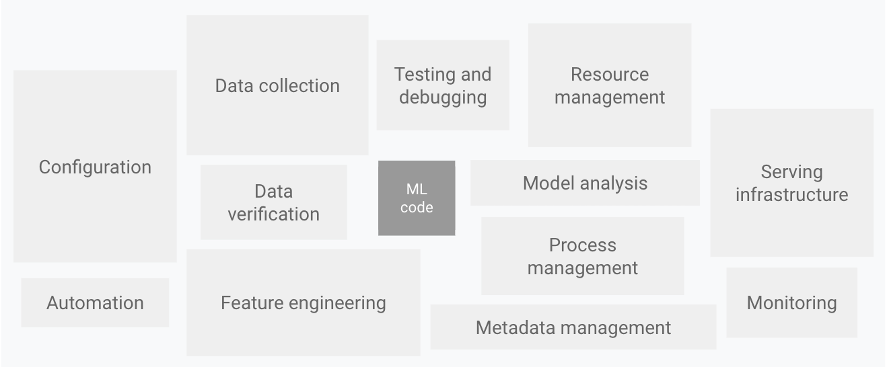
SUBJECT- Final Year Project
Department:- Computer Engineering
Architecture
Stage 1: Feature Engineering & EDA
Academic Year 2024-25

Slide 15
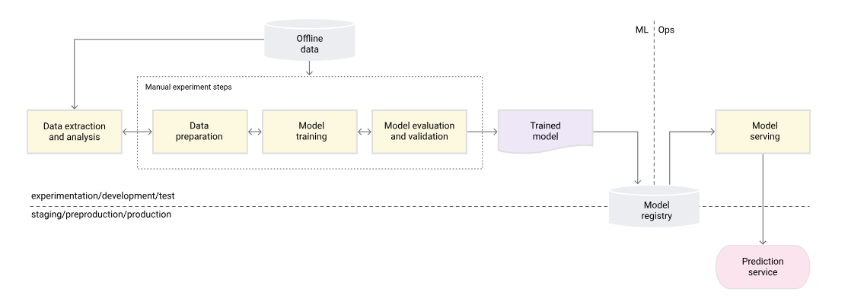
SUBJECT- Final Year Project
Department:- Computer Engineering
Architecture
Stage 2: ML Manual Process
Academic Year 2024-25

Slide 16
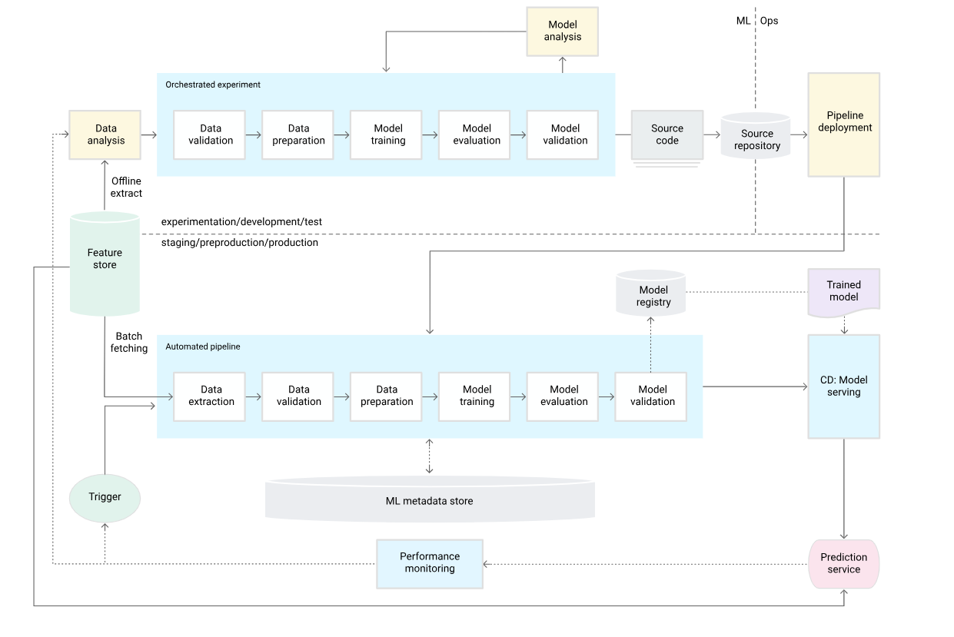
SUBJECT- Final Year Project
Department:- Computer Engineering
Architecture
Stage 3: ML pipeline automation
Academic Year 2024-25

Slide 17
SUBJECT- Final Year Project
Department:- Computer Engineering
Future scope
Integration with Electronic Health Records (EHRs):
Extend the project to interface with hospital EHR systems for real-time drug type prediction.
Automate the prescription process using patient health records.
Personalized Drug Recommendations:
Expand the model to provide personalized drug dosages based on more patient-specific factors like genetic data.
Adapt to lifestyle, diet, and environmental factors for even more accurate predictions.
Academic Year 2024-25

Slide 18
SUBJECT- Final Year Project
Department:- Computer Engineering
Incorporating More Features:
Include additional patient attributes like medical history, lifestyle habits (e.g., smoking, drinking), and family history of diseases.
Use sensor data or wearable health devices to improve real-time decision-making.
AI-Powered Diagnosis:
Use deep learning models to extend the system for predicting potential side effects and optimizing treatment plans.
Develop a chatbot or virtual assistant for doctors and patients to interact with the system for drug suggestions.
Model Optimization:
Explore advanced algorithms such as deep neural networks, ensemble methods, or reinforcement learning to enhance prediction accuracy.
Implement online learning for continuous model updates based on new data.
Academic Year 2024-25

Slide 19
SUBJECT- Final Year Project
Department:- Computer Engineering
Results
Model Accuracy:
Achieved an accuracy of [XX]% in predicting the correct drug type for patients.
The model shows strong performance with minimal errors in drug type prediction.
Performance Metrics:
Precision: [XX]% for Drug A, [XX]% for Drug B, etc.
Recall: [XX]% for Drug A, [XX]% for Drug B, etc.
F1 Score: Balanced metric of precision and recall showing the reliability of the model.
Academic Year 2024-25

Slide 20
SUBJECT- Final Year Project
Department:- Computer Engineering
Confusion Matrix:
Visual representation of the model’s performance in categorizing each drug type.
Highlights areas of improvement, e.g., where Drug B was mistakenly predicted as Drug C
Feature Importance:
Factors like age, blood pressure, and cholesterol levels had the most significant impact on drug predictions.
Model shows higher confidence when age and BP data are combined.
Overall System Efficiency:
Successfully reduced the time taken to recommend a drug by automating the prediction process.
Improved accuracy in drug prescriptions compared to manual methods.
Academic Year 2024-25

Slide 21
SUBJECT- Final Year Project
Department:- Computer Engineering
Conclusion
In summary, our project successfully developed a machine learning model that accurately predicts drug types based on patient data, aiding healthcare providers in making informed decisions and enhancing patient outcomes. By streamlining the drug prescription process, our system minimizes human error and boosts efficiency, ensuring patients receive accurate and personalized drug recommendations. This innovative approach not only improves patient safety but also paves the way for more effective healthcare practices.
Academic Year 2024-25

Slide 22
SUBJECT- Final Year Project
Department:- Computer Engineering
Thank You
Academic Year 2023-24

